Slide 1
CS 4530 Software Engineering
Lecture 9.1: Why Engineer Distributed Software?
Jonathan Bell, Adeel Bhutta, Ferdinand Vesely, Mitch Wand
Khoury College of Computer Sciences
© 2022, released under CC BY-SA

Slide 2
Learning Objectives for this Lesson
By the end of this lesson, you should be able to…
Decide why would you want to build your system as a distributed system
Describe 5 key goals of distributed systems
Analyze a system’s requirements and determine if it should be implemented as a distributed system or not

Slide 3





What is a distributed system?
Model:
Many servers talking through a network
Model:
Many servers and clients talking through a network
Notes:
First: some ground rules. What is a distributed system? Most apps that we work with are distributed in some way, at least in the sense that there is some code that runs in a client, and elsewhere on a server. For this and the following lesson, however, we’ll focus on two particular distributed systems models: where we are focusing on the SERVER aspects, and distributed the server code across multiple computers, with a network between them

Slide 4
Why expand to distributed systems?
Scalability
Performance
Latency
Availability
Fault Tolerance
“Distributed Systems for Fun and Profit”, Takada
Notes:
Why go through the effort of implementing, deploying and maintaining a distributed system? Here are the general goals a DS should address. We’ll look at a motivating example next.
Scale: size (more nodes), geographic (reduce time to respond to users), administration (administrators per machine)

Slide 5
Example: Domain Name System (DNS)
Problem Statement
Nodes (hosts) on a network are identified by IP addresses
E.g.: 142.251.41.4
We humans prefer something easier to remember: calendar.google.com, facebook.com, www.khoury.northeastern.edu
We need to keep a directory of domain names and their addresses
We also need to make sure everybody gets directed to the correct host

Slide 6
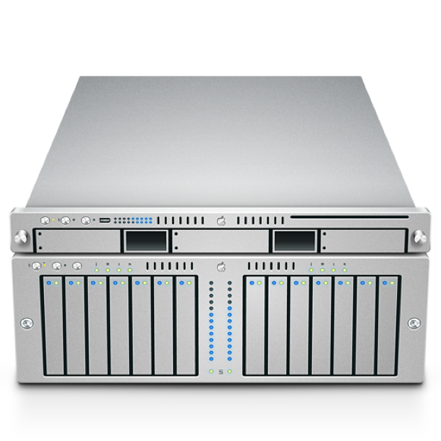

Example: Domain Name System (DNS)
Need to handle millions of DNS queries per second
Not immediately obvious how to scale: how do we maintain replication, some measure of consistency?
DNS Server
facebook.com?
31.13.66.35

Slide 7
Domain Name System
Obvious solution: Use a Local file
Keep local copy of mapping from all hosts to all IPs (e.g., /etc/hosts)
Hosts change IPs regularly: Download file frequently
Lot of constant internet bandwidth use
IPv4 space is now full
32-bits: 4,294,967,296 addresses
At 1 byte per address, file would be 4GB
Not a lot of disk space (now, DNS introduced in the late 80s)
Notes:
One obvious solution: keep DNS mappings locally.
Since IPs change regularly -> We can keep the file up to date by syncing it with a remote version.

Slide 8
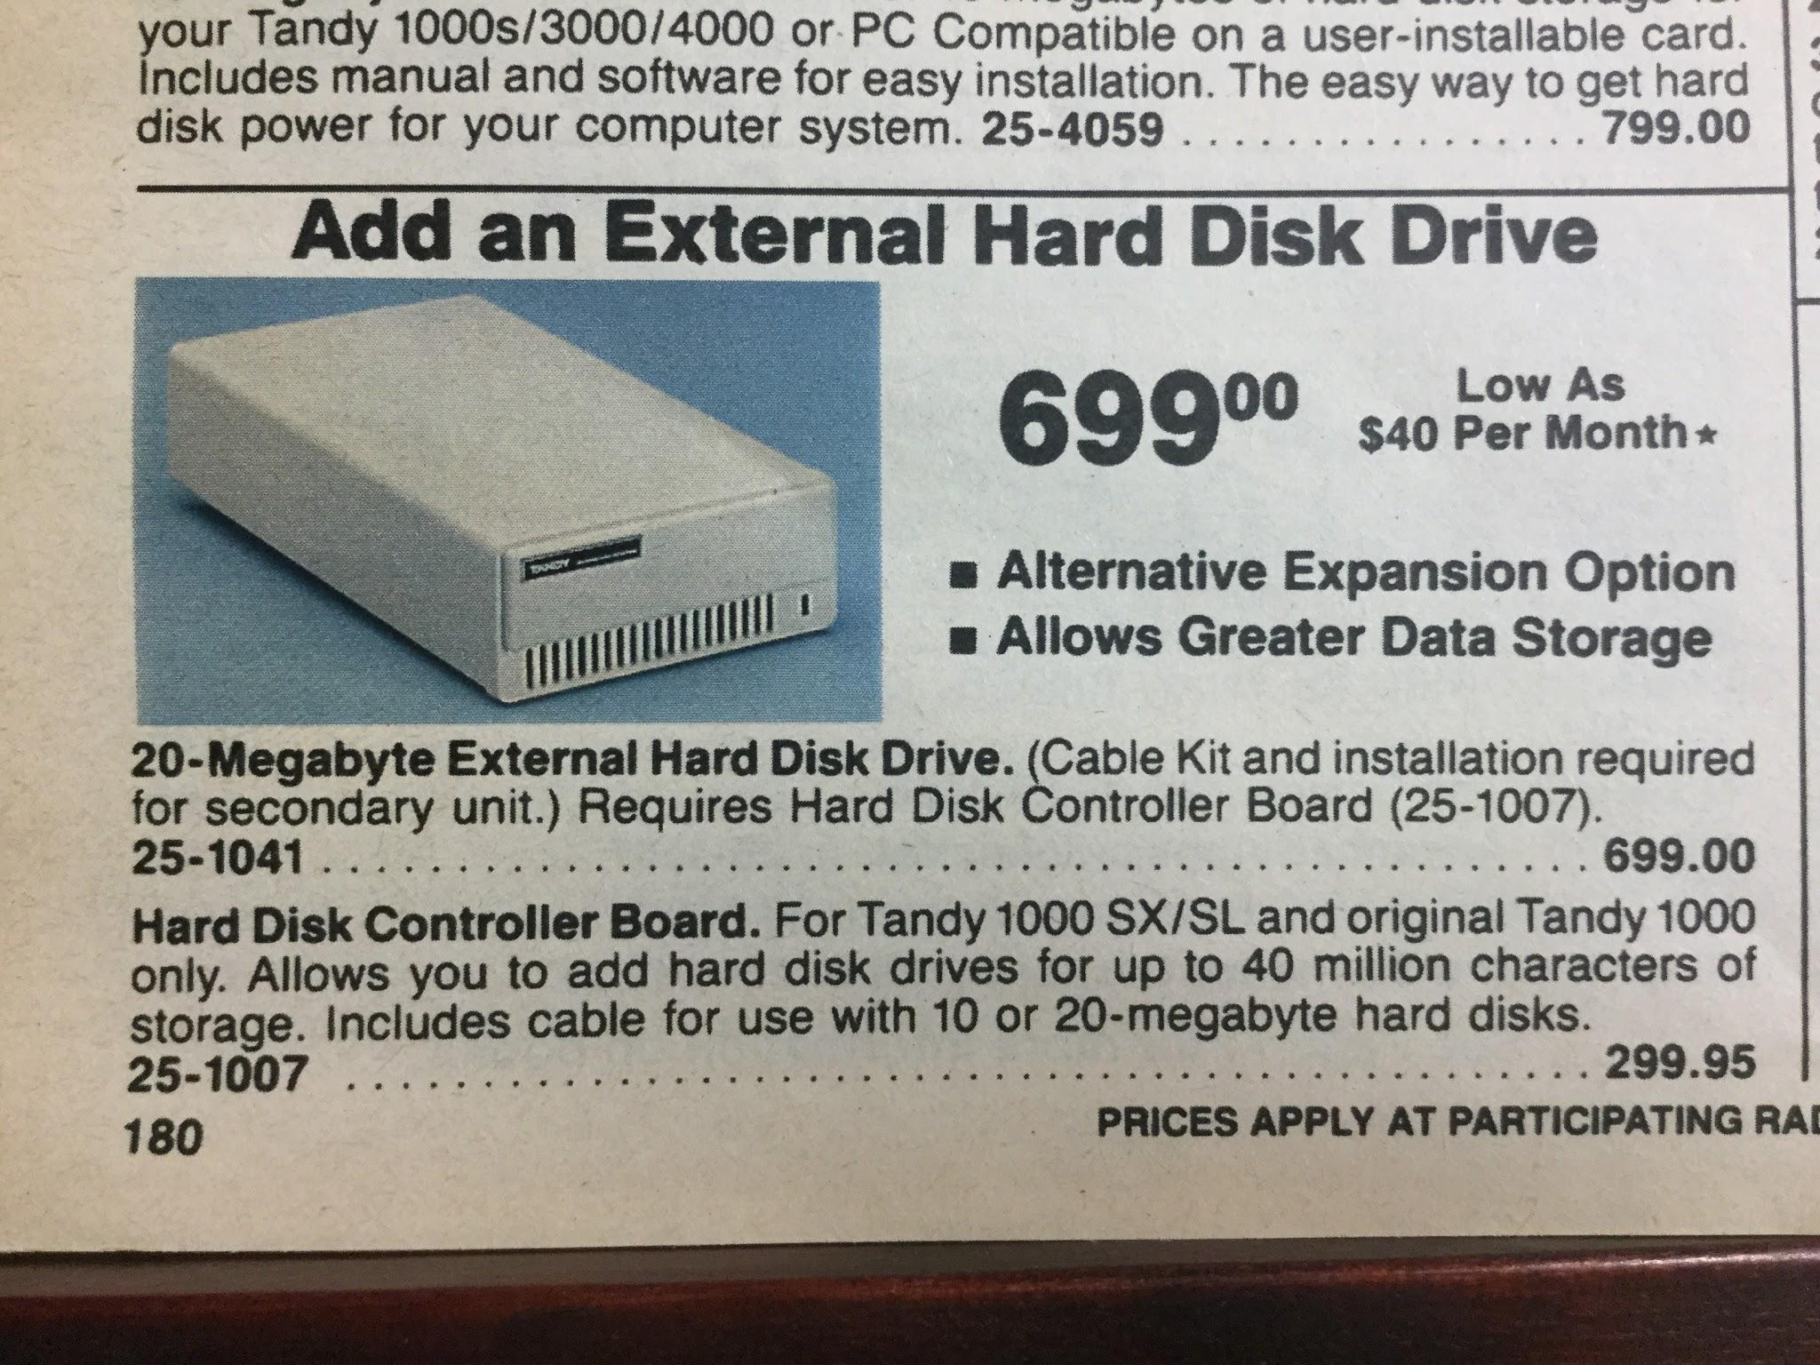
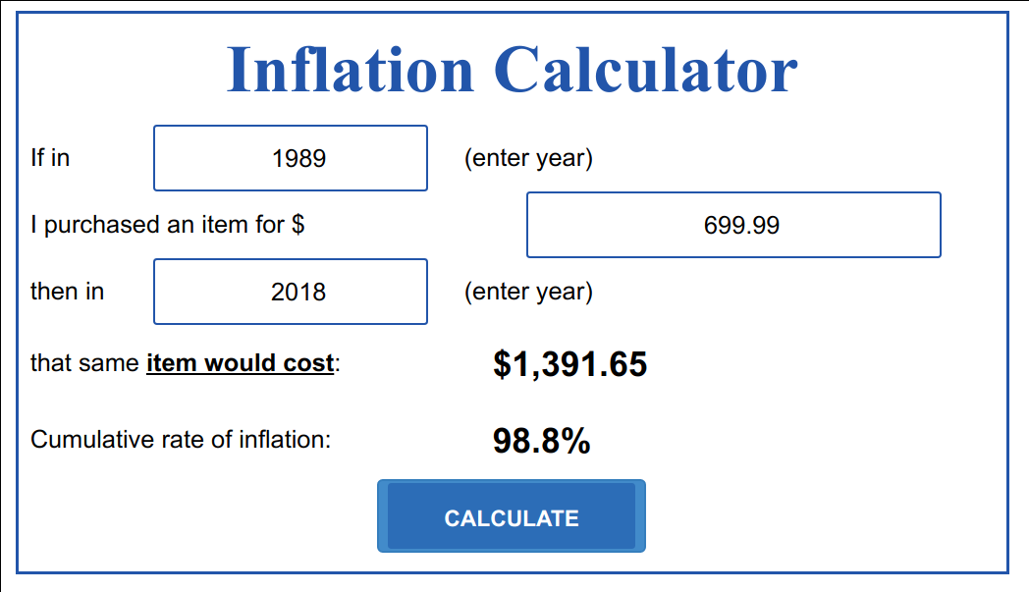
Domain Name System
Obvious solution: Use a Local file
Keep local copy of mapping from all hosts to all IPs (e.g., /etc/hosts)
Hosts change IPs regularly: Download file frequently
Lot of constant internet bandwidth use
IPv4 space is now full
32-bits: 4,294,967,296 addresses
At 1 byte per address, file would be 4GB
Not a lot of disk space (now, DNS introduced in the late 80s)
We need 200x of these to hold 4GB: $270K+
Notes:
The storage needed is not much of a problem from nowadays perspective, even if it is wasteful.
Ad from 1989

Slide 9
Domain Name System
Obvious solution: Use a Local file
Keep local copy of mapping from all hosts to all IPs (e.g., /etc/hosts)
Hosts change IPs regularly: Download file frequently
IPv4 space is now full
32-bits: 4,294,967,296 addresses
At 1 byte per address, file would be 4GB
Not a lot of disk space (now, DNS introduced in the late 80s)
But a lot of constant internet bandwidth
More names than IPs
Aliases
Not scalable!

Slide 10
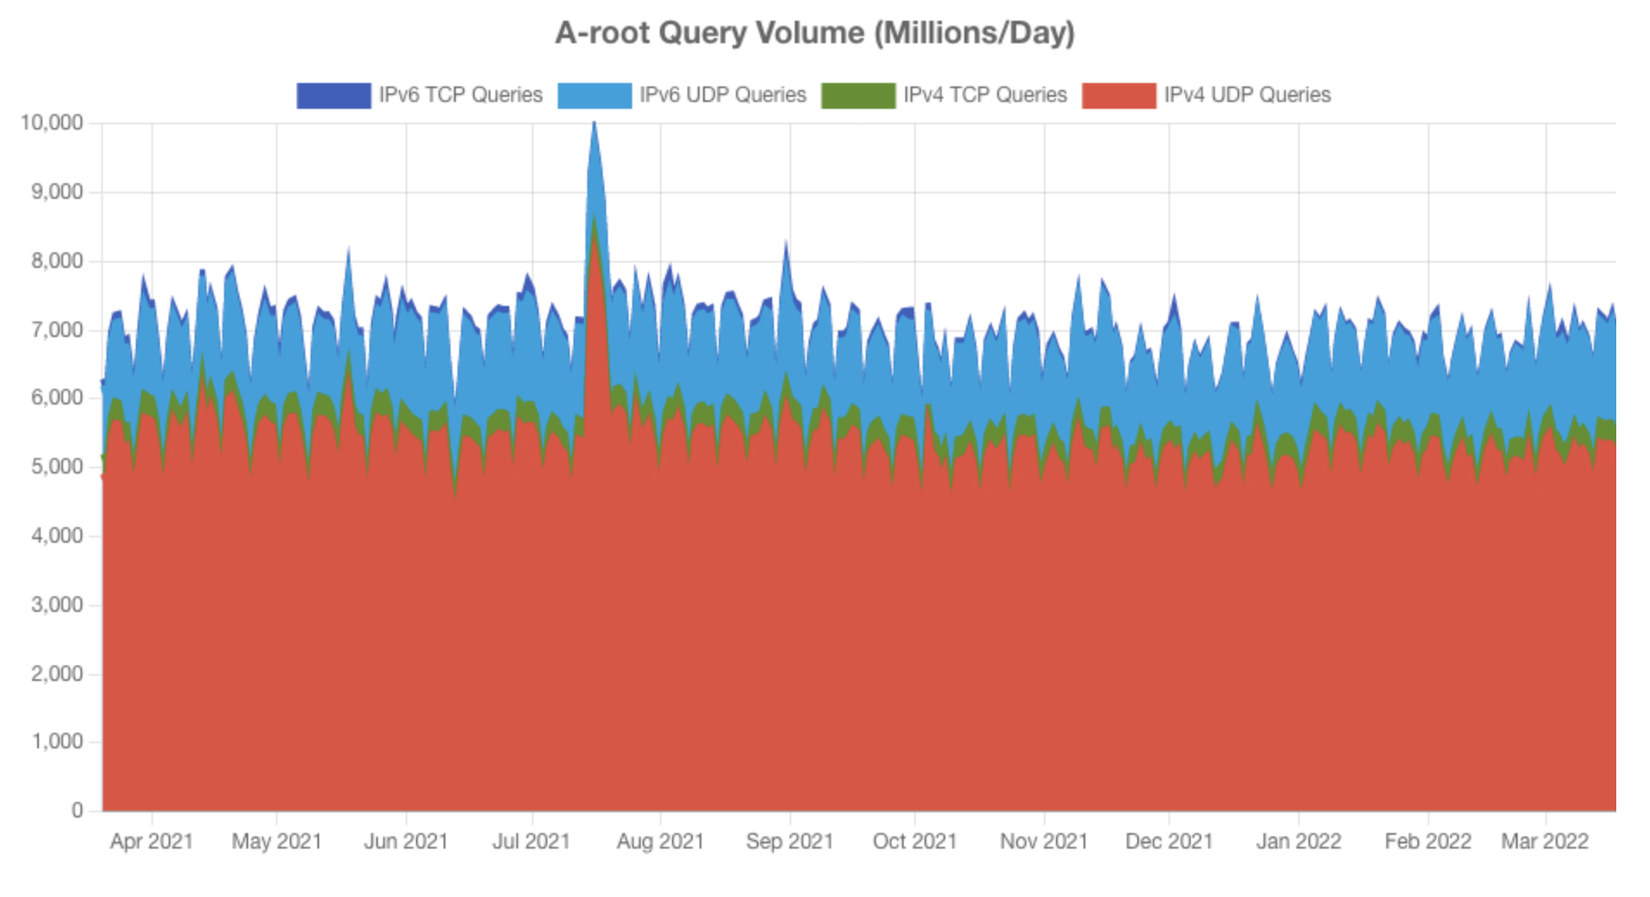
Domain Name System
Another Obvious Solution: Well-known centralized server
Single point of failure
Traffic volume
Access time
Ultimately, not scalable!
https://a.root-servers.org/metrics
Notes:
Verisign root servers, only handling a portion of the DNS traffic worldwide (~15%)

Slide 11
DNS as a distributed system
We need a scalable solution
New hosts keep being added
Number of users increases
Need to maintain speed/responsiveness
We need our service to be available and fault tolerant
It is a crucial basic service
A problematic node shouldn’t “crash the internet”
Parts of the system should be maintainable independently
E.g., national domains
Maintaining it shouldn’t add significant amount of traffic
Global in scope
Domain names mean the same thing everywhere
Notes:
It’s ok if server A tells you that the address for a name is an older address, as long as it’s not too old. Probably, that address is still valid for the time it takes for all servers to update.

Slide 12
Distributed Systems Goals
“the ability of a system, network, or process, to handle a growing amount of work in a capable manner or its ability to be enlarged to accommodate that growth.”
Scalability
Performance
Latency
Availability
Fault Tolerance
“Distributed Systems for Fun and Profit”, Takada
Notes:
So, when are distributed systems useful? Why go through the trouble? We know what we want for DNS as a distributed system. Here are again the general goals a distributed system is trying to address, in more detail.
Most things are easy to do small: Let’s make a system that lets 5 people run around a 2D map. Great! How do we let 100,000 people run around that same map? Uh-oh. A scalable system is one in which adding more work (more usage) does not make things incrementally worse: We want to be able to increase the capacity and usage of our service without it slowing to a halt.

Slide 13
Distributed Systems Goals
“is characterized by the amount of useful work accomplished by a computer system compared to the time and resources used.”
Scalability
Performance
Latency
Availability
Fault Tolerance
“Distributed Systems for Fun and Profit”, Takada
Notes:
measured perhaps by throughput, utilization of resources, response time (see latency)

Slide 14
Distributed Systems Goals
“The state of being latent; delay, a period between the initiation of something and the it becoming visible.”
Scalability
Performance
Latency
Availability
Fault Tolerance
“Distributed Systems for Fun and Profit”, Takada
Notes:
pesky limits: speed of light, RAM/hard drives/CPUs. but for distributed systems can come in much more

Slide 15
Distributed Systems Goals
“the proportion of time a system is in a functioning condition. If a user cannot access the system, it is said to be unavailable.”
Scalability
Performance
Latency
Availability
Fault Tolerance
Availability = uptime / (uptime + downtime).
Often measured in “nines”
Availability % | Downtime/year
90% | >1 month
99% | < 4 days
99.9% | < 9 hours
99.99% | <1 hour
99.999% | 5 minutes
99.9999% | 31 seconds
“Distributed Systems for Fun and Profit”, Takada
Notes:
hard to handle availability on a single machine. because we want redundancy. CLICK to show table we want to take a bunch of unreliable components and build a bigger thing that itself is reliable. what are the components and what kinds of redundancy can we provide?
Availability considers things more broadly than uptime though: what if there is a network outage? Without knowing every possible thing that can fail, instead, we might design for fault tolerance

Slide 16
Distributed Systems Goals
“ability of a system to behave in a well-defined manner once faults occur”
Scalability
Performance
Latency
Availability
Fault Tolerance
What kind of faults?
Disks fail
Networking fails
Power supplies fail
Security breached
Datacenter goes offline
Power goes out
“Distributed Systems for Fun and Profit”, Takada
Notes:
Which is to say: can we define a set of faults that we expect, and then design a system to tolerate them? We concede that we can’t tolerate all faults. If nothing else, our service might degrade in availability if our business goes bankrupt!

Slide 17
Challenges
More machines, more problems
Say there’s a 1% chance of having some hardware failure occur to a machine (power supply burns out, hard disk crashes, etc)
Now I have 10 machines
Probability(at least one fails) = 1 - Probability(no machine fails) = 1-(1-.01)¹⁰ = 10%
100 machines -> 63%
200 machines -> 87%
Notes:
Fault tolerance is a tricky beast, however.
So obviously just adding more machines doesn’t solve fault tolerance

Slide 18
Challenges
Number of nodes + distance between them
Notes:
an increase in the number of independent nodes increases the probability of failure in a system (reducing availability and increasing administrative costs)
an increase in the number of independent nodes may increase the need for communication between nodes (reducing performance as scale increases)

Slide 19


Challenges
Number of nodes + distance between them
SF
NY
Even if cross-city links are fast and cheap (are they?)
Still that pesky speed of light…
DC
LONDON
Notes:
an increase in geographic distance increases the minimum latency for communication between distant nodes (reducing performance for certain operations)

Slide 20

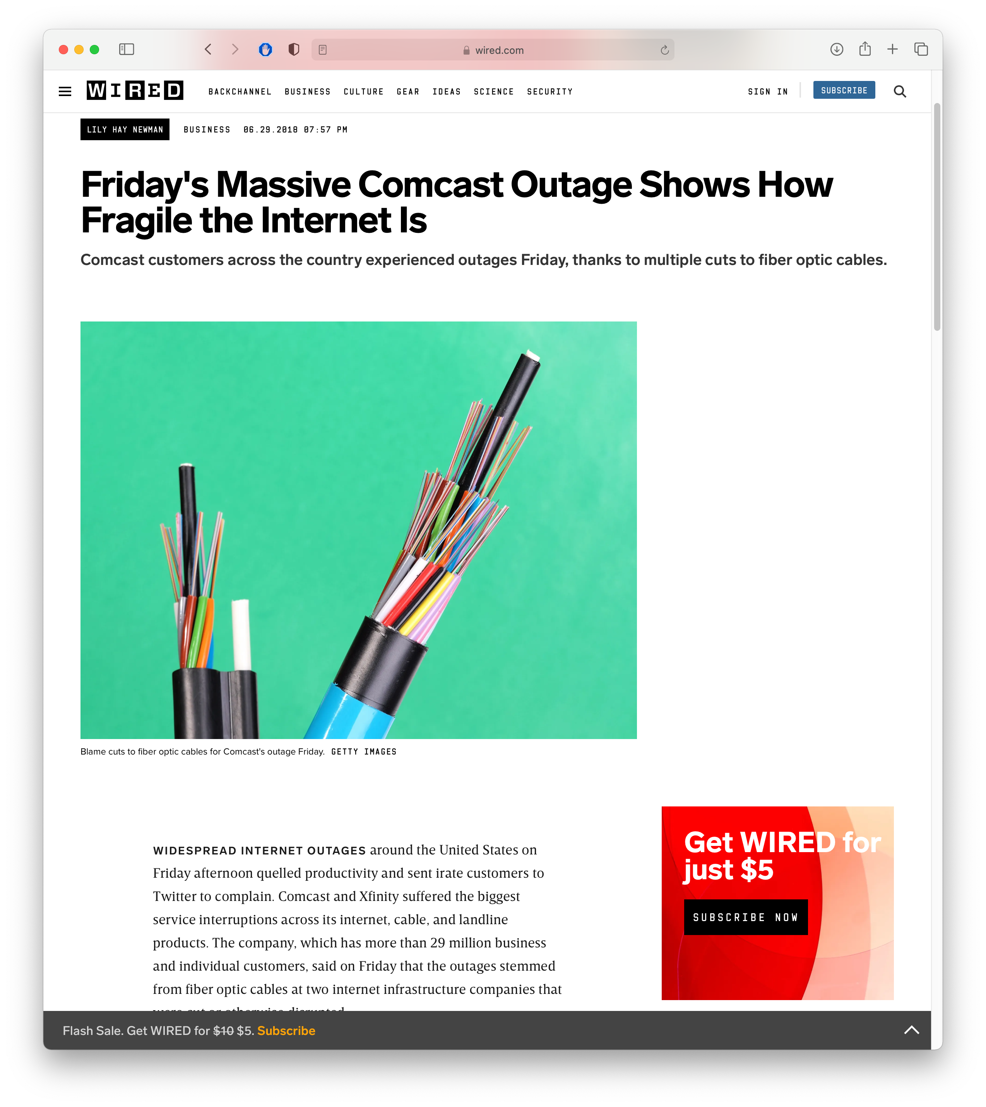
What can go wrong?
Networks still fail, intermittently and for prolonged periods

Slide 21
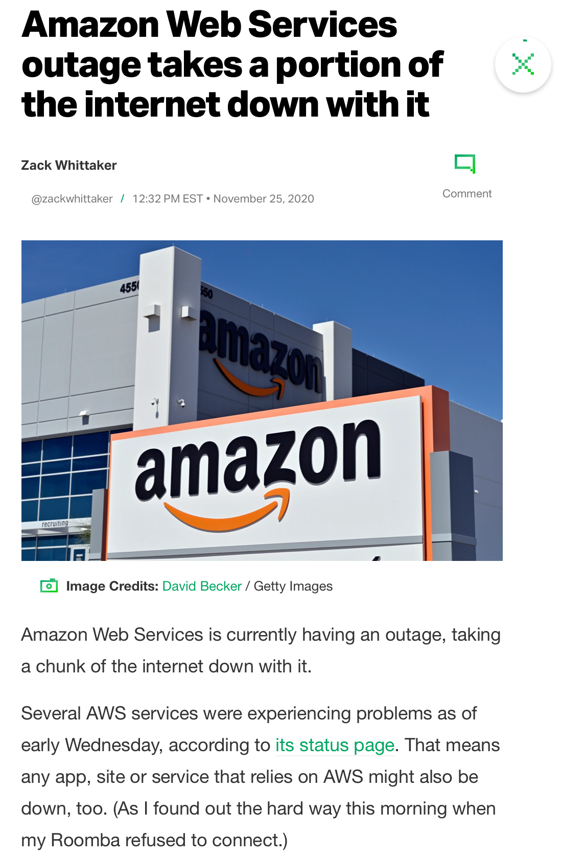
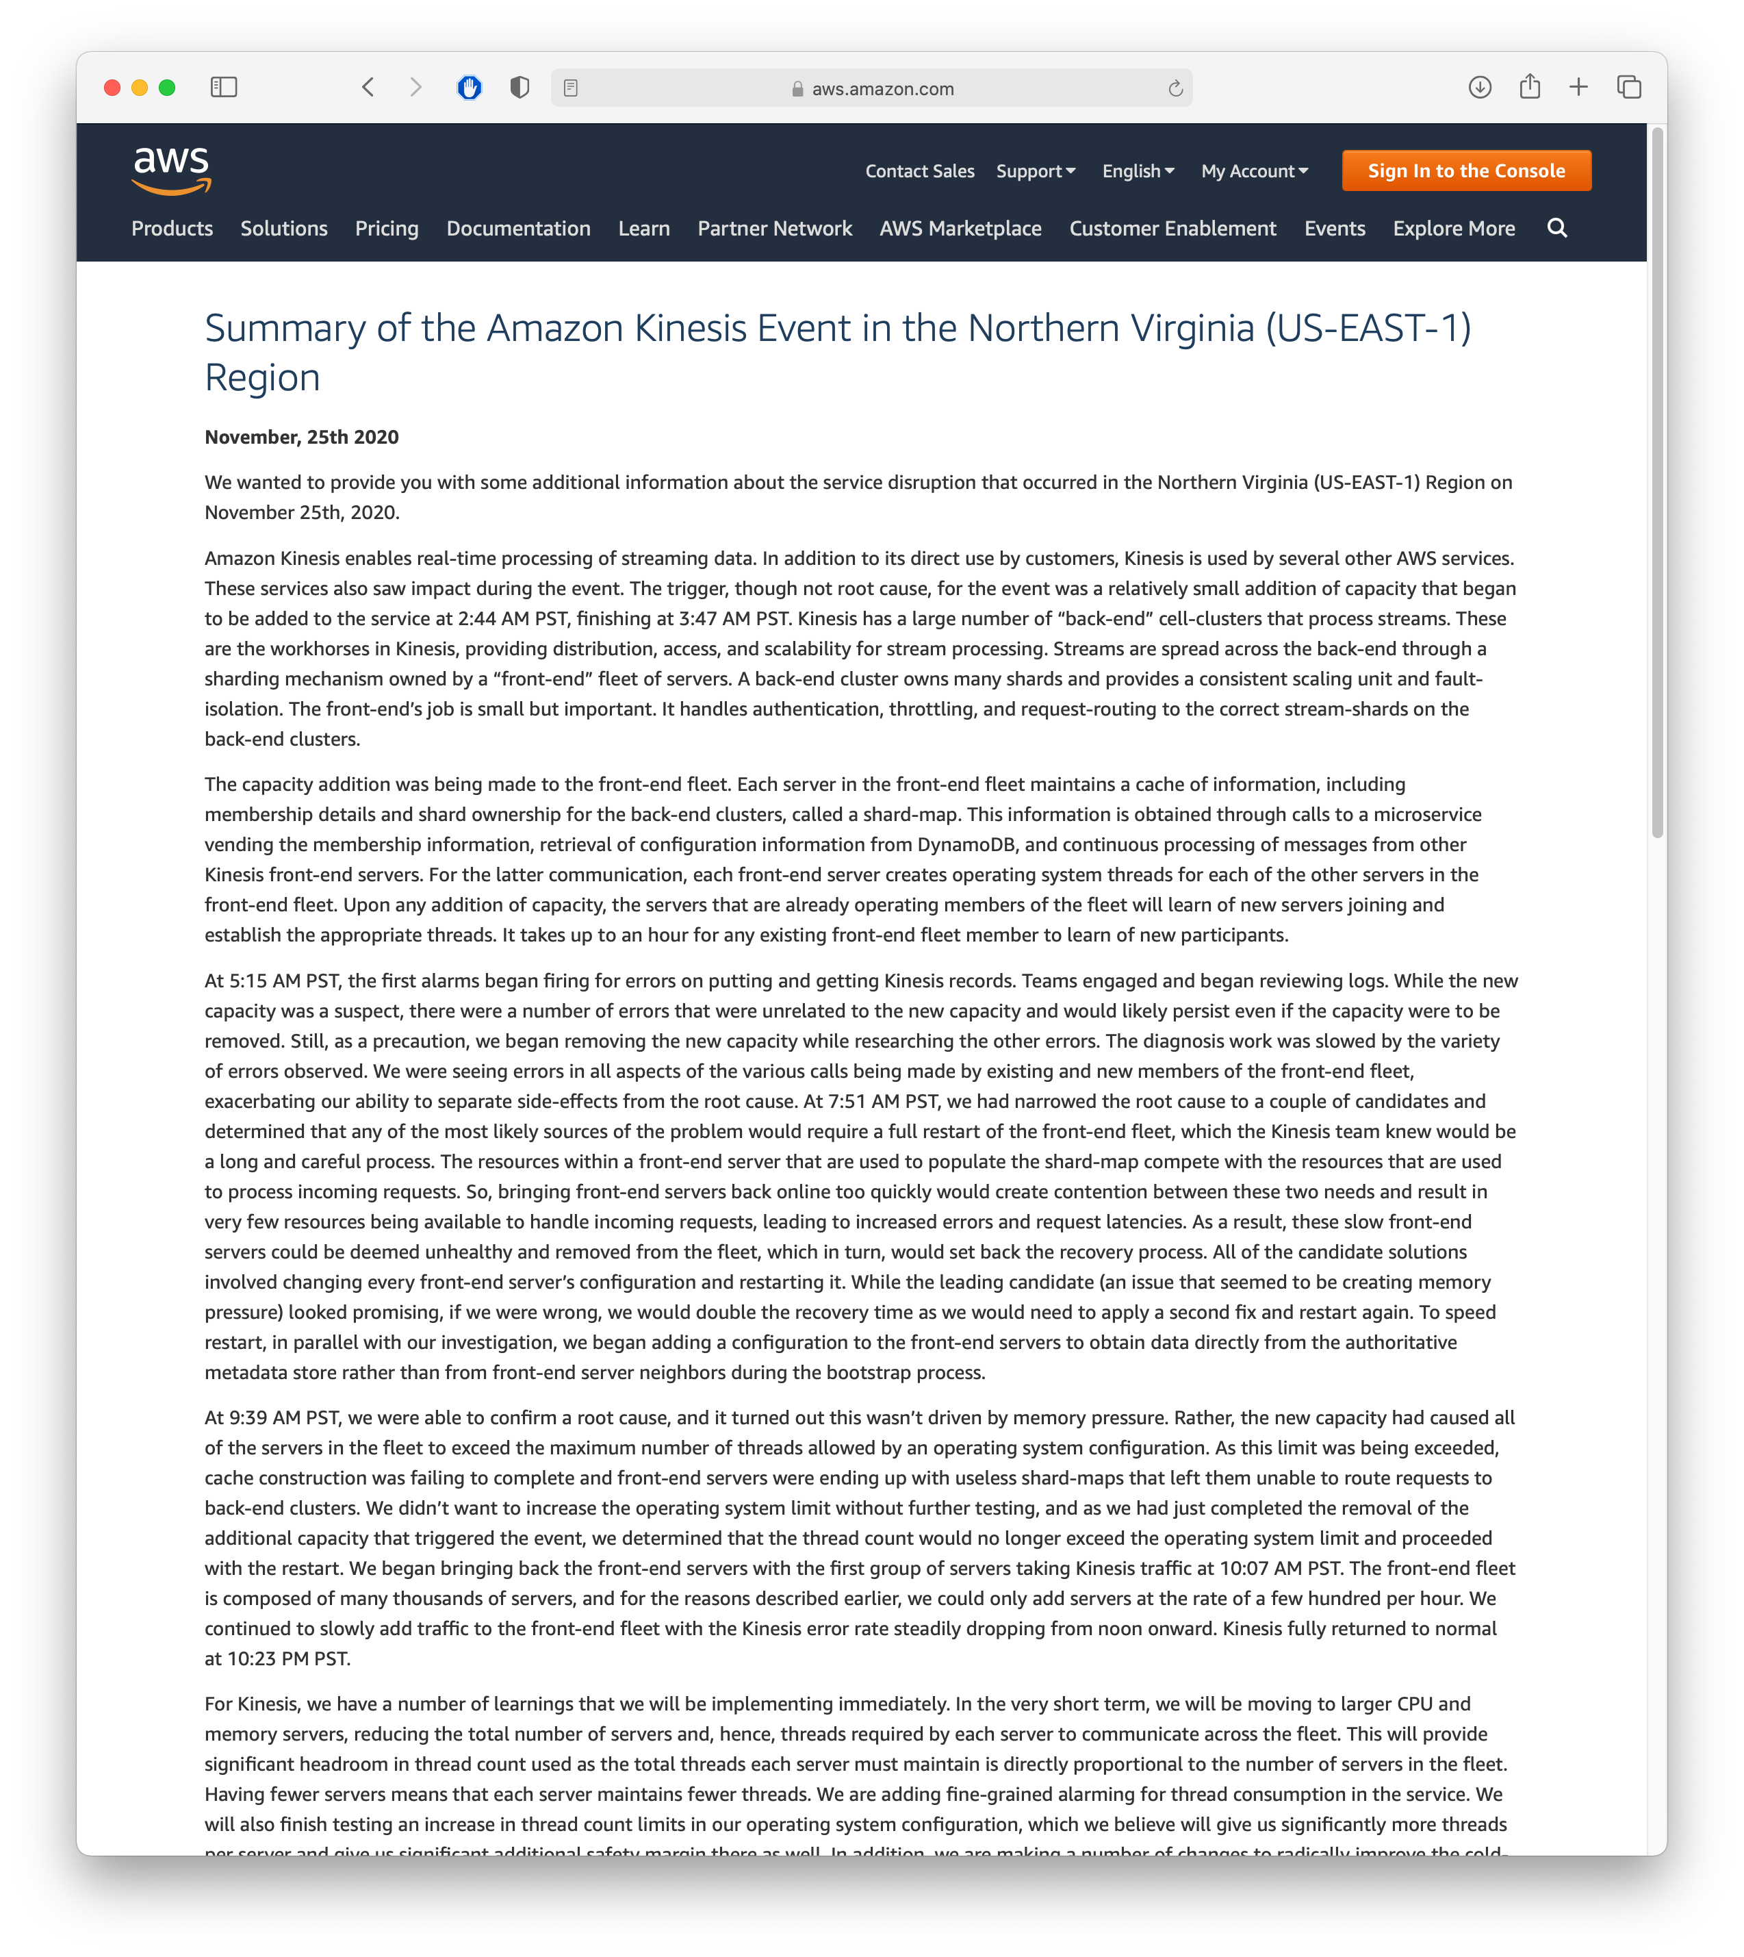
What can go wrong?
We still rely on other administrators, who are not infallible

Slide 22
Should we make our software distributed?
Reflecting on goals + challenges
Do we need to store more data than one computer can store?
Do we need to process requests faster than one computer can?
Are we willing and able to take on these additional complications?
Next lesson: what tools do we have at our disposal?

